Slide 1
Kubernetes workshop I
What’s it all about?
Andrey Sorokin & Vsevolod Kabrits
1

Slide 2
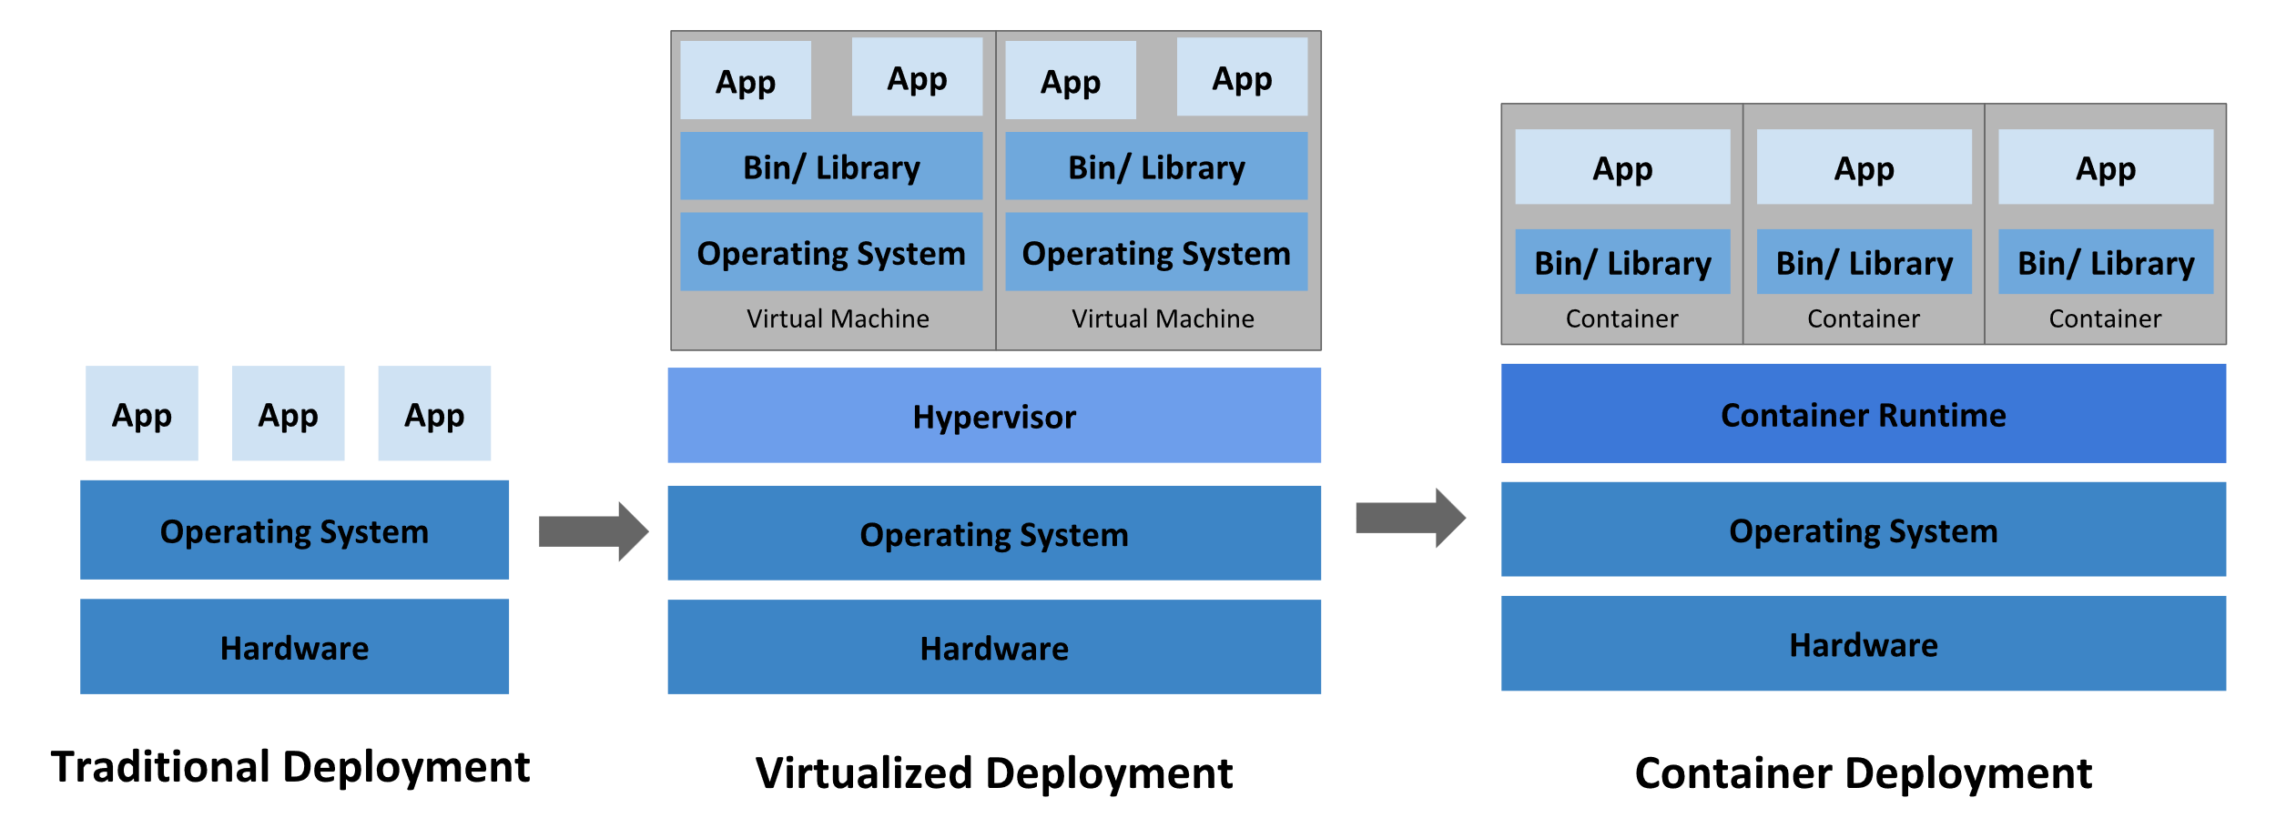
Why Kubernetes?
4

Slide 3
Nodes & Namespaces
.yaml
Master Node
Api Server
Worker Node
Worker Node
Worker Node
Namespace 1
Namespace 2
Namespace 3
.yaml
.yaml
.yaml
.yaml
.yaml
.yaml
4

Slide 4
Pods
Master Node
Worker Node
Worker Node
Worker Node
Pod
Pod
Pod
Pod
Pod
Pod
Pod
4

Slide 5
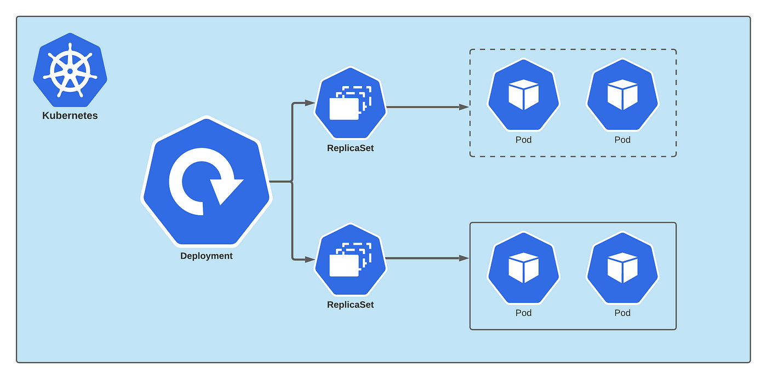
Deployment
4

Slide 6
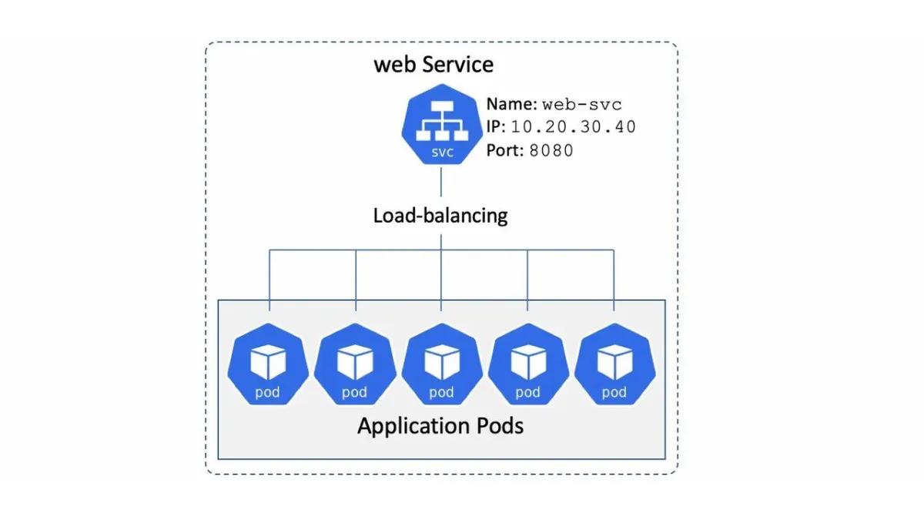
Service
4

Slide 7
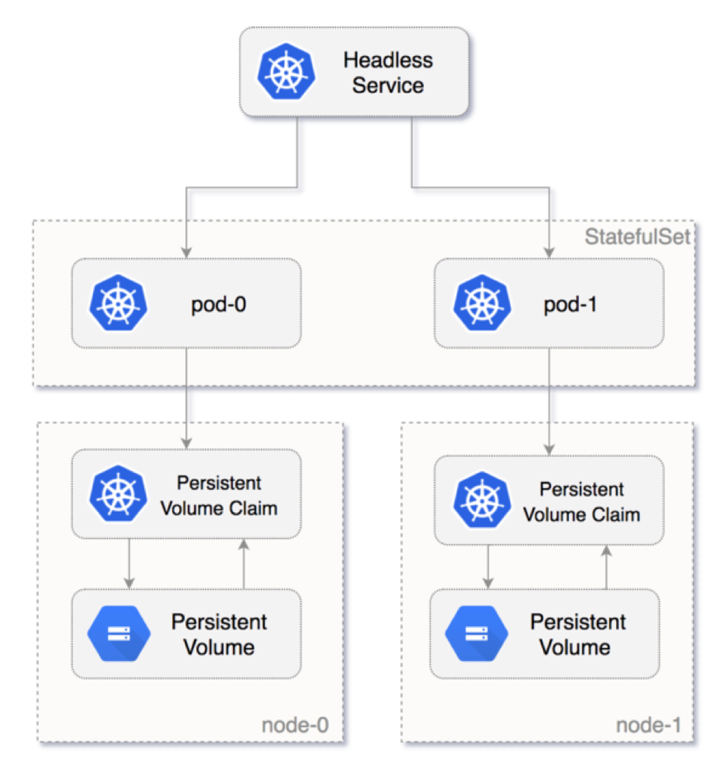
StatefulSet
4

Slide 8
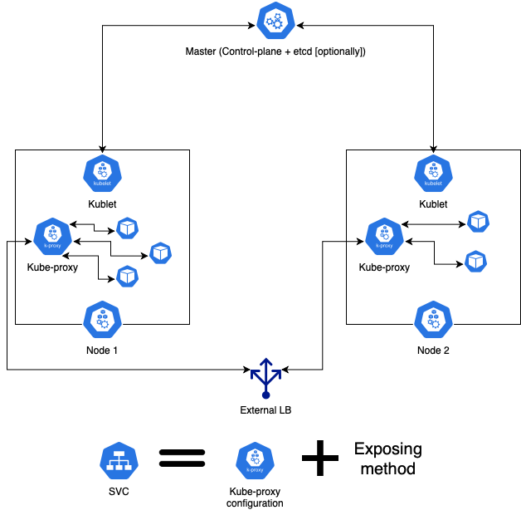
K8s reality
17

Slide 9
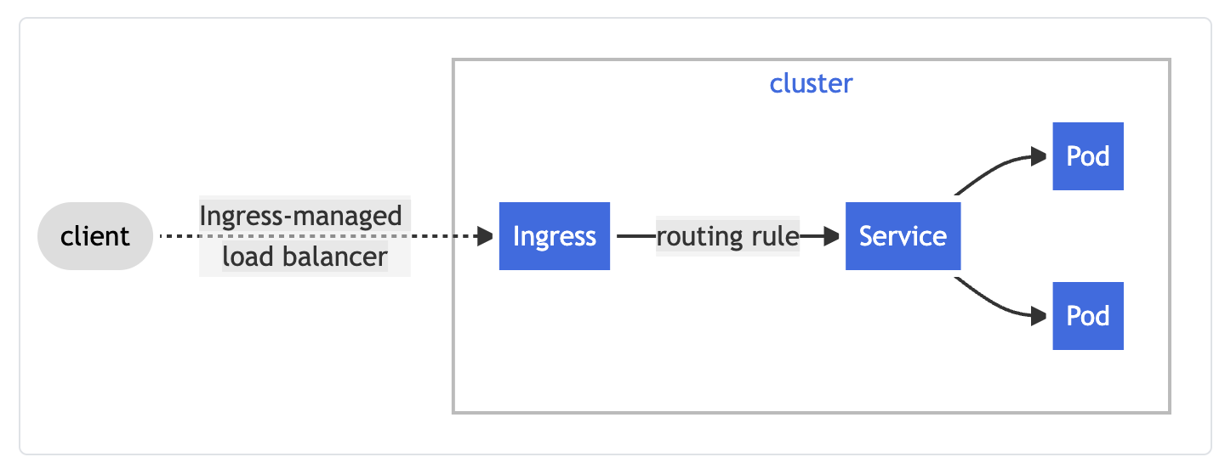
Ingress
4

Slide 10
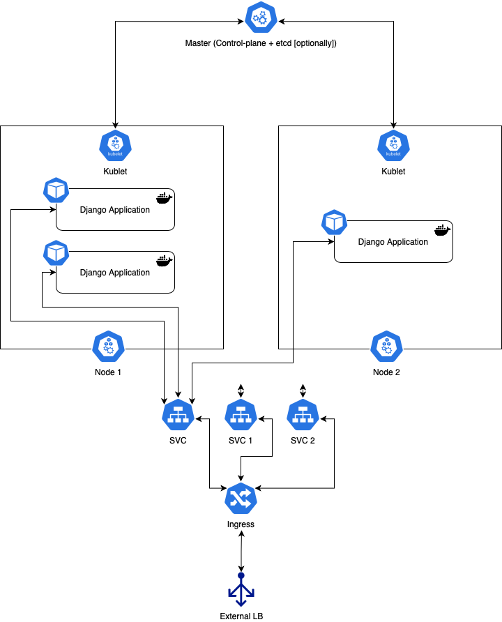
K8s abstraction
18

Slide 11
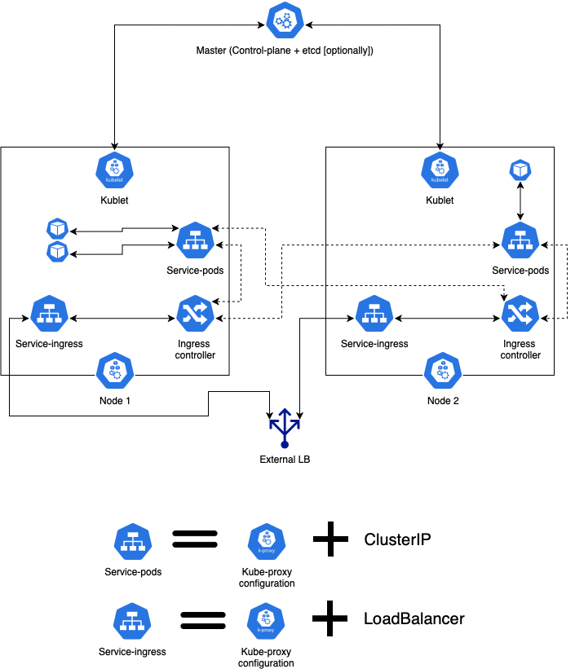
K8s more details
5

Slide 12
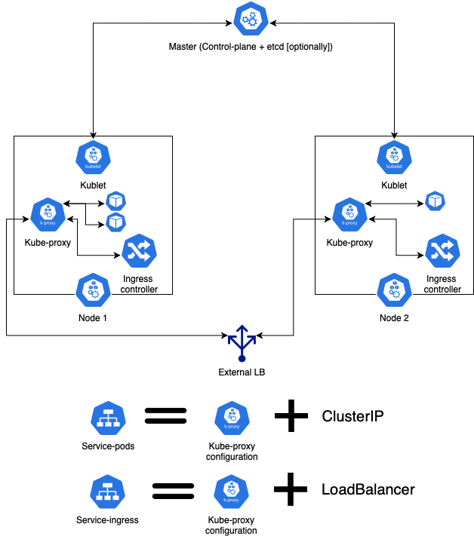
K8s reality
4

Slide 13
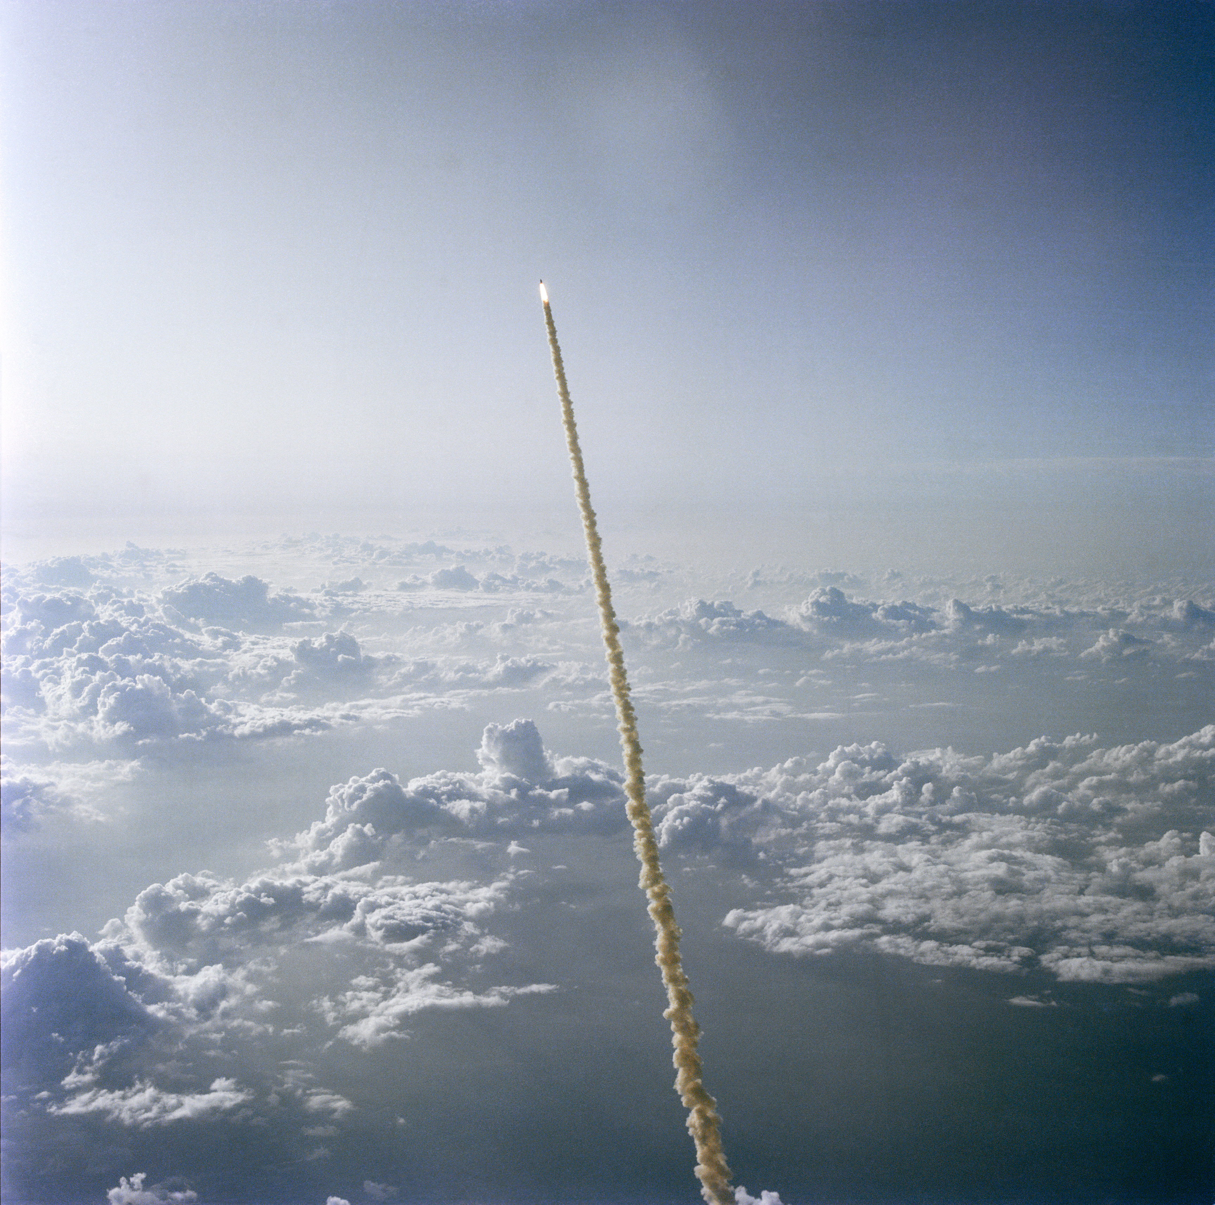
Thank you for your attention
Application
Cluster infrastructure
16

